Slide 1


TRAINER
ANISA VARASTEH
TRAUMA-INFORMED PRACTICE

Slide 2

ACKNOWLEDGEMENT OF COUNTRY
WWW.RELATEINSTITUTE.COM.AU

Slide 3


GOALS
  Describe what trauma is
  Understand the impact and relevance of trauma
  Understand Trauma Informed Care and how to create psychological safety
WWW.RELATEINSTITUTE.COM.AU

Slide 4

THIS TRAINING CONTAINS
Reference to :
•Traumatic events
•Childhood trauma
•Impact of trauma
WWW.RELATEINSTITUTE.COM.AU
Notes:
In this training there will be discussions about different types of trauma including childhood trauma. There will be no details about traumatic event, just general reference.
Please let the participants know that they can leave the room at any stage if something upsets them but that you (or a delegate) will check in on them and debrief.

Slide 5

DESCRIBE AN IDEAL CLIENT
What would you notice in their behaviour?
WWW.RELATEINSTITUTE.COM.AU
Notes:
After the list is created explain trauma-informed care increases the posibility of these behaviours. We will explain how, later.

Slide 6

TRAUMA-INFORMED PRACTICE
The goal of trauma informed practice is to interact with people in a way that creates a sense of psychological safety.
It is about giving people choice and control over decisions that affect them so they can build feelings of control and empowerment.
WWW.RELATEINSTITUTE.COM.AU
Notes:
Trauma informed care is an overall way of working with people not a specific set of techniques.
Trauma informed care is the understanding that many people we come to contact with have experienced a level of trauma in their past. We need to interact with them in a way that demonstrates compassion and care in every opportunity we have.

Slide 7

KEY IDEA: “DO NO HARM.”
Trauma-informed care is NOT about talking with people about their traumatic experiences.
You CAN provide trauma-informed care without talking﻿ to people about such experiences.
WWW.RELATEINSTITUTE.COM.AU
Notes:
Sometimes, when people do not want to talk or not ready to talk about such experiences, it can re-traumatize them.

Slide 8

WHAT IS TRAUMA?
Any experience that causes extreme stress reaction and is perceived as life threatening by the individual.
WWW.RELATEINSTITUTE.COM.AU
Notes:
The perception of threat is important in defining trauma.
It is important to note that trauma is a subjective experience. 2 people may go through the same experience and one may experience a trauma response in their body and mind and one may not.
Trauma is not necessarily direct exposure, it may be witnessing traumatic events

Slide 9
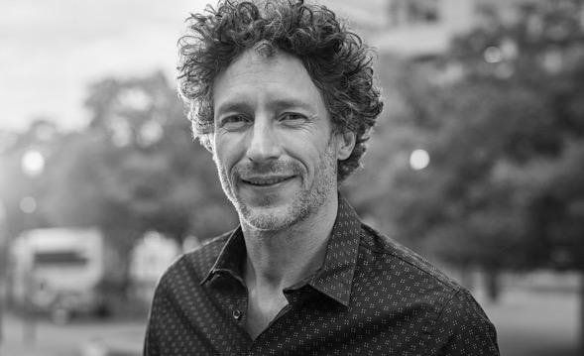





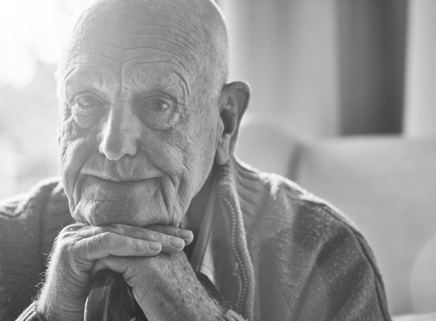

TRAUMA PREVELANCE
57–75% of Australians will experience a potentially traumatic event at some point in
their lives
62–68% of young people will have been exposed to at least 1 traumatic event by the age of 17
12% of Australians experience PTSD in their life
Australian institute of Health & welfare, 2020
Notes:
Being aware of how common trauma is and what a trauma response might look like helps you adjust your practice in many ways, including how to interact people and the language that you use.

Slide 10

FIGHT/FLIGHT/ FREEZE RESPONSE
www.youtube.com/watch?v=jEHwB1PG_-Q&ab_channel=Braive
WWW.RELATEINSTITUTE.COM.AU
Notes:
To understand trauma and its effects better we need to understand what happens in the brain when we go through a life-threatening experience(s)

Slide 11



REFLECTION
Think about the last worst day you had.
What did you do that day after the event?
What was your intention?
WWW.RELATEINSTITUTE.COM.AU
Notes:
After time for reflection invite the participants to share their responses with the group. The aim of this activity is to recognise that we all respond to difficult situations in ways to feel better. The responses may not be effective or healthy in the long run but the intention is always to feel better. For example after a particularly draining week, we may have a glass of wine, or sleep in, or ‘binge’ on watching Netflix.
Similarly, clients’ intention is always to feel better. Quite often the ways they act helps them deal with the impact of trauma . Although from the outside it may look like a harmful behaviour (e.g. smoking, gambling, aggressive behaviours).
Every behaviour makes sense in context but it doesn’t mean that every behaviour is ok or healthy. This view helps us relate to people with compassion and understand what is driving their behaviour.

Slide 12

TRAUMA IMPACT:
Physical
Unexpected chronic pain or numbness
Chronic fatigue
Sleep problems
Breathing problems
Digestive problems
WWW.RELATEINSTITUTE.COM.AU

Slide 13
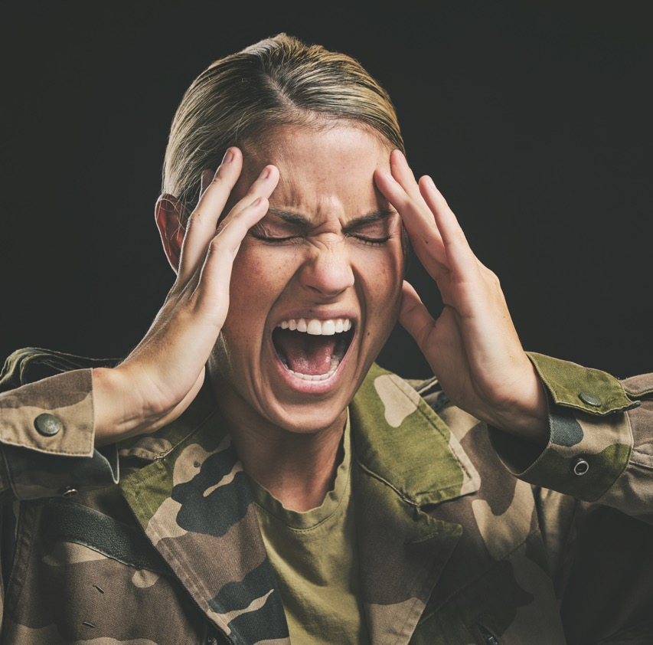
TRAUMA IMPACT: EMOTIONAL & Cognitive
Flashbacks
A sate of terror when no danger is present
Depression
Anxiety
Difficulty concentrating
Compulsive behaviours
Anger outburst
Dissociation
Nightmares
WWW.RELATEINSTITUTE.COM.AU

Slide 14

TRAUMA IMPACT: EMOTIONAL & COGNITIVE
WWW.RELATEINSTITUTE.COM.AU
Notes:
As part of a study a group of veterans who were diagnosed with PTSD were given a Rorschach test. Rorschach test is a meaningless stimuli (an ink blot) and the participants were asked what they see. Many people see clowns or butterflies or 2 people playing a game. The veterans stories were different. One participant said: “this is that child I saw being blown up in Vietnam.” out of the 22 participants, 16 of them on seeing the second card reacted as if they were experiencing a wartime trauma. The researchers learnt from these Rorschach tests that traumatised people have a tendency to superimpose their trauma on everything around them and have trouble deciphering what is going on around them. They also learnt that trauma affects imagination. Imagination is absolutely critical to our lives. It gives us the opportunity to envision new possibilities. when people are compulsively and consistently pulled back in the past, to the time when they felt intense involvement and emotions they suffer from a failure of imagination, a loss of the mental flexibility. Without imagination there is no hope, no chance to envision a better future, no place to go, no goals to reach.
Traumatised people look at the world differently from other people. For most people a man coming down the street is just someone taking a walk. a rape victim, however, may see a person who is about to molest him and go into a panic.

Slide 15

TRAUMA IMPACT: INTERPERSONAL
Frequent conflicts in relationships
Lack of trust
Difficulty establishing and maintaining relationships
Difficulty setting boundaries
WWW.RELATEINSTITUTE.COM.AU
Notes:
Often people with these challenges come across “manipulative” or “difficult”

Slide 16

TRAUMA IMPACT: BEHAVIOURAL
Substance use
Difficulty enjoying time with friends and family
Avoiding specific people/places/situations
Disordered eating
Self-harm
High risk sexual behaviour
WWW.RELATEINSTITUTE.COM.AU
Notes:
Often people with these challenges come across “manipulative” or “difficult”

Slide 17

A shift in perspective
“What happened to you?”
instead of
“What is wrong with you?”
WWW.RELATEINSTITUTE.COM.AU
Notes:
Unresolved trauma has pervasive effects, and may impair a wide range of functioning, radically restricting the individual’s capacity to respond flexibly to daily stress and life challenges. Many symptoms and challenging behaviours should be reappraised as responses to trauma, with a focus not on what is wrong with this person but what has happened to them.
Please highlight that this is a shift in perspective and not a literal advice to ask clients about their history of trauma.

Slide 18
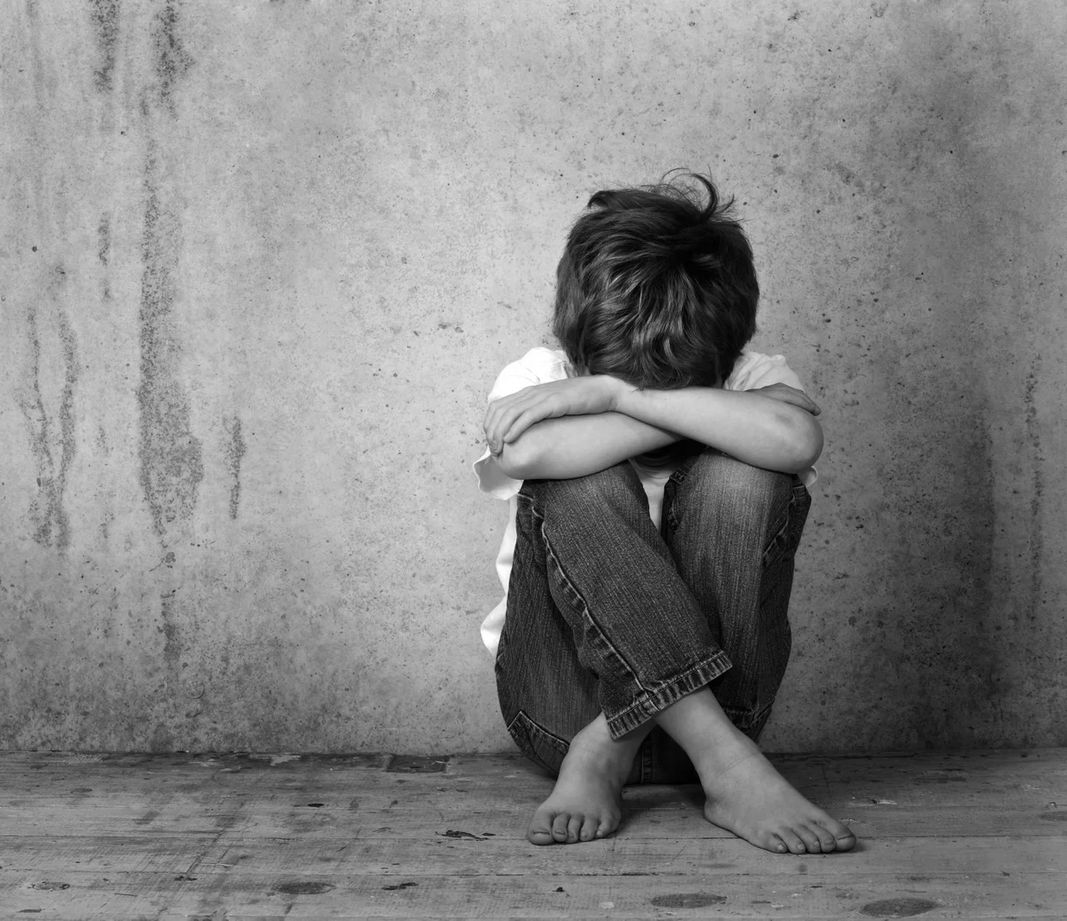
COMPLEX TRAUMA
Cumulative
Repetitive
Interpersonal
Usually in childhood
WWW.RELATEINSTITUTE.COM.AU
Notes:
In this training we are going to talk more about complex trauma.
Complex trauma is cumulative, repetitive and interpersonally generated rather than a ‘single incident trauma’. The prolonged exposure to distressing experiences during childhood has an impact on people’s emotional development, identity, and neurobiology which may then result in social and functional difficulties. Typically in situations of complex trauma a person has on-going difficulties with self regulation (self soothing) and has the stress experiences embedded in bodily reactions (somatic responses).

Slide 19
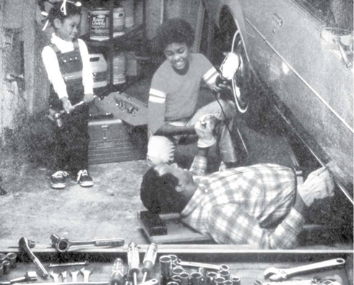
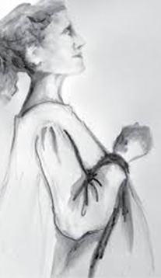
IMPACT OF COMPLEX TRAUMA
WWW.RELATEINSTITUTE.COM.AU
Notes:
Bassesl van der Kolk. In a study 2 groups of children were shown these pictures and asked what was happening in the picture. One group were children who were traumatised and the other group children with no known history of trauma.
The first picture: a seemingly innocent picture of a pregnant woman. When shown to the traumatised group they told stories of abuse. One seven-year-old girl who was sexually abused at the age of 4 continuously talked about penises and vaginas and kept asking a female researcher: “how many people have humped you?”
A girl from the other group (no history of trauma) told a story about a widowed lady sadly looking out the window missing her husband but in the end she found a loving man to be a good father for her child.
Second picture: Two smiling kids watching dad repair a car. All the children with no history of trauma told stories with benign endings (the car would get fixed and maybe dad and the kids would drive to McDonalds). The traumatised kids came up with gruesome tales. One girl said that the little girl in the picture was about to smash in her father’s skull with a hammer. A nine-year old boy who had been severely physically abused told an elaborate story about how the boy in the picture kicked away the jack so that the car would kill his father.
The conclusion of the study was: many seemingly innocent benign stimuli in the environment can trigger intense feelings of danger, aggression or terror. So for traumatised people the whole world is potentially filled with triggers.

Slide 20








TRIGGERS
Trigger
Anything that stimulates an escalation in a trauma response
Individual Triggers
Are specific to the individual and their life experiences
Universal Triggers
A perceived power imbalance,
confusion, embarrassment, fear, confined spaces, loss of control, being ignored, uncertainty
Notes:
Triggers are quite specific to the individual and their life experiences, cultural background, social situation. A trigger is anything that stimulates an escalation in a trauma response (such as fight, flight, freeze).
Common triggers may include: a perceived power imbalance, embarrassment, confusion, rudeness, fear, being patronised, ignored, frustrated, not taken seriously or being dismissed or overlooked.

Slide 21

TRAUMA-INFORMED PRINCIPLES
  Create safety
  Offer choice and control
WWW.RELATEINSTITUTE.COM.AU

Slide 22

CREATE safety
Physical Environment
Emotional Environment
Self-Awareness
Notes:
Many people who have gone through trauma feel unsafe in new environments. Some feel unsafe in any environment. By creating safety you show you that you understand trauma and how people might feel as a result.
e.g. sound minds: exit, telling them you can leave
Refer back to the list the group made about their ideal client. Explain when humans feel safe it is more likely they demonstrate these behaviours.

Slide 23

CREATING PSYCHOLOGICAL SAFETY
  Choice of Meeting Formats and Locations
  Offer Control Over the Pace of Information Sharing
  Ask Open-Ended Questions. E.g. “What do I need to know about you to be most helpful to you?”
  Offer Breaks
  Seek Verbal Confirmation Before Discussing Sensitive Topics.
WWW.RELATEINSTITUTE.COM.AU
Notes:
Trauma is common but as we mentioned earlier not everyone’s experience is the same.
To understand the impact we need to ask: “how can I understand this person?”
When you engage with people in this way you help the person actively participate in their care.
Young refugee their goal was to have a gender affirming surgery.

Slide 24
What is the Message Behind the Words?
"Women are all fake and untrustworthy."
You havent been able to trust most women in your life.
WWW.RELATEINSTITUTE.COM.AU

Slide 25
What is the Message Behind the Words?
“Are you even a real lawyer?”
“Can you hear yourself talking?”
WWW.RELATEINSTITUTE.COM.AU

Slide 26

CREATING A SAFE RELATIONSHIP
  Clarity and Transparency in Processes
  Consistency
  Compassion
WWW.RELATEINSTITUTE.COM.AU
Notes:
Being transparent about what you can and cant do, the scope of the service, the procedures evolved, etc. can create a sense of predictability which is important to feeling of safety.
Similarly consistency helps with predictability and sense of safety.
giving people options even if they are small can help.
E.g. Acupuncture.

Slide 27

CHOICE & Control
WWW.RELATEINSTITUTE.COM.AU
Notes:
Trauma often leaves people feel helpless, fearful and out of control. As a support person, it is important that we do not recreate any parts of the traumatic event (unintentionally). This is why trauma informed care includes collaborating with the client and offering choice. When people have a sense of personal control in interactions with people who have more power, they can feel safe and this can be very healing. In this way THEY can start to recognise their strengths and take control of their lives.

Slide 28

SCENARIO
Nathan, a lawyer specialising in employment law, is representing a client named Maria who has filed a complaint of workplace harassment against her supervisor. Maria has been experiencing severe anxiety and distress as a result of the harassment, and she is hesitant to proceed with the legal process.
During their meeting, Maria confides in Nathan that she feels overwhelmed and powerless in the face of the harassment. She expresses concern about potential retaliation from her employer and worries about the impact the legal proceedings may have on her career.
WWW.RELATEINSTITUTE.COM.AU
Notes:
At time it may feel that there are not many options to offer the client. But there always are, although they may be limited, or they may be ones that the client doesn't like but the purpose of offering choices is not to ‘please’ the client but to help them recognise in each moment there are options available to them.
Break the big group into small groups and ask them to discuss what options they can offer Benjamin.
Some example:
“would you like to take a support person to go with you?” notice this is different to: “would you like me to come with you?” the first question provides an opportunity for Benjamin to say no if doesn’t want to without feeling he would reject ‘you’.
If he said yes to support, then you could ask: “who would you like to take with you as your support?” again this is an open question with opportunity for choice.
“What day would suit you? What time?”
Another option which we (and the client) may not like is he can choose to refuse the offer. In that case it is important for Benjamin to know this is an option but be aware of the potential consequences (e.g. he may not be offered anther option at Housing SA) so that he can make an informed decision.

Slide 29

LANGUAGE & COMMUNICATION
  Use simple, everyday conversational language.
  Repeat explanations and ask the person to repeat back.
  Is English a second language? Is an interpreter required?
  Use appropriate language at the person’s level of understanding.
  Avoid jargon.
WWW.RELATEINSTITUTE.COM.AU
Notes:
Using a trauma informed care approach requires a shift in language. Often the behaviors and responses trauma survivors display are labelled in ways that view survivors as having something wrong with them.
Quite often when we work in an organization or a sector we have ways of talking and a vocabulary all our own. Those terms and acronyms can be confusing to people who work with you, now imagine how confusing they are to someone looking for help? When someone reaches out for help, a lot of emotions come to the surface: fear, anger, frustration, desperation, etc. We need to ensure that we are speaking so others understand.

